Slide 1
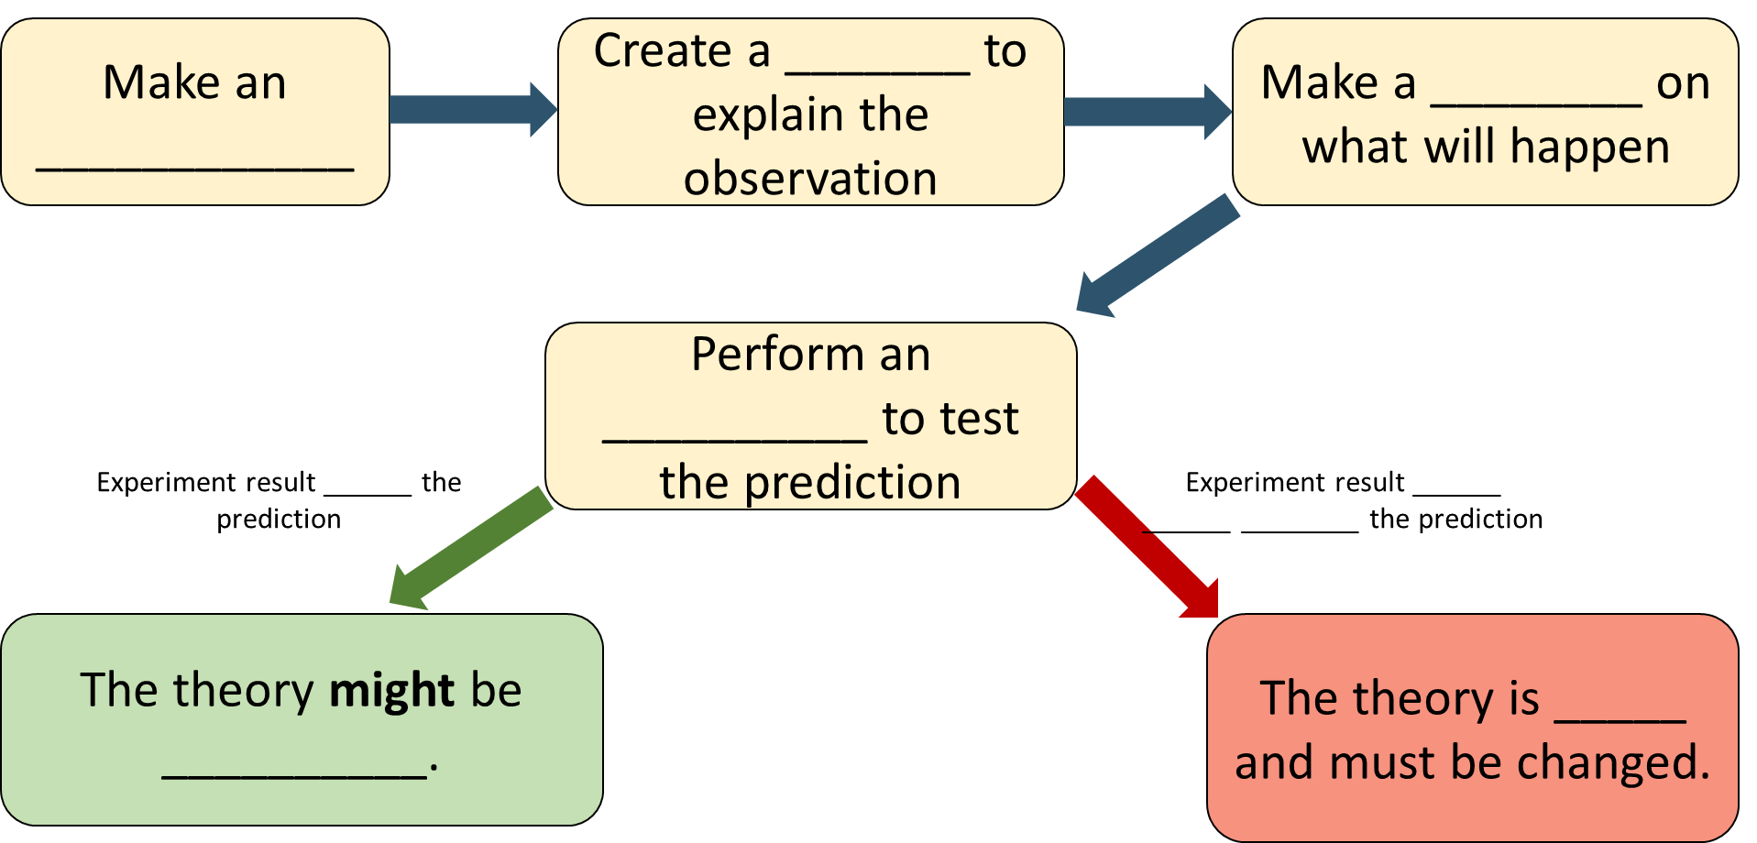
What is Science?
Name: _________________________
Q1 True or false:
Science is always changing.
Science is the collection of knowledge about the world.
If my experiment didn’t match my prediction, I didn’t do science correctly.
Science is the method of finding out more about the world.
I need a university degree to do science.
Scientific knowledge can be tested.
True False
True False
True False
True False
True False
True False
Q2 Fill in the blanks:
Q3 In your own words, define ‘science’.

Slide 2
What is Science?
What do you have in your life thanks to science and technology?
What questions do you have about the world?

Slide 3
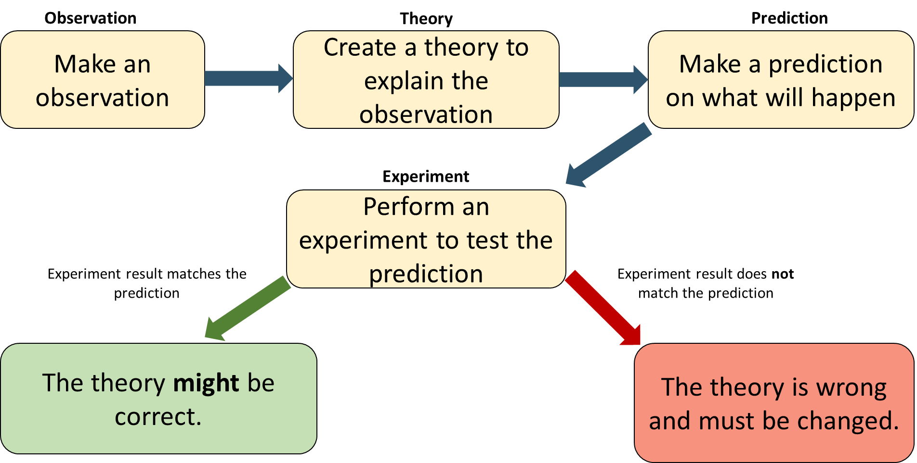
What is Science?
Name: _________________________
True or false:
Science is always changing.
Science is the collection of knowledge about the world.
If my experiment didn’t match my prediction, I didn’t do science correctly.
Science is the method of finding out more about the world.
I need a university degree to do science.
Scientific knowledge can be tested.
True False
True False
True False
True False
True False
True False
Make an ____________
Create a _______ to explain the observation
Make a ________ on what will happen
Perform an __________ to test the prediction
Experiment result ______ the prediction
Experiment result ______ ______ ________ the prediction
The theory might be __________.
The theory is _____ and must be changed.

